Slide 1
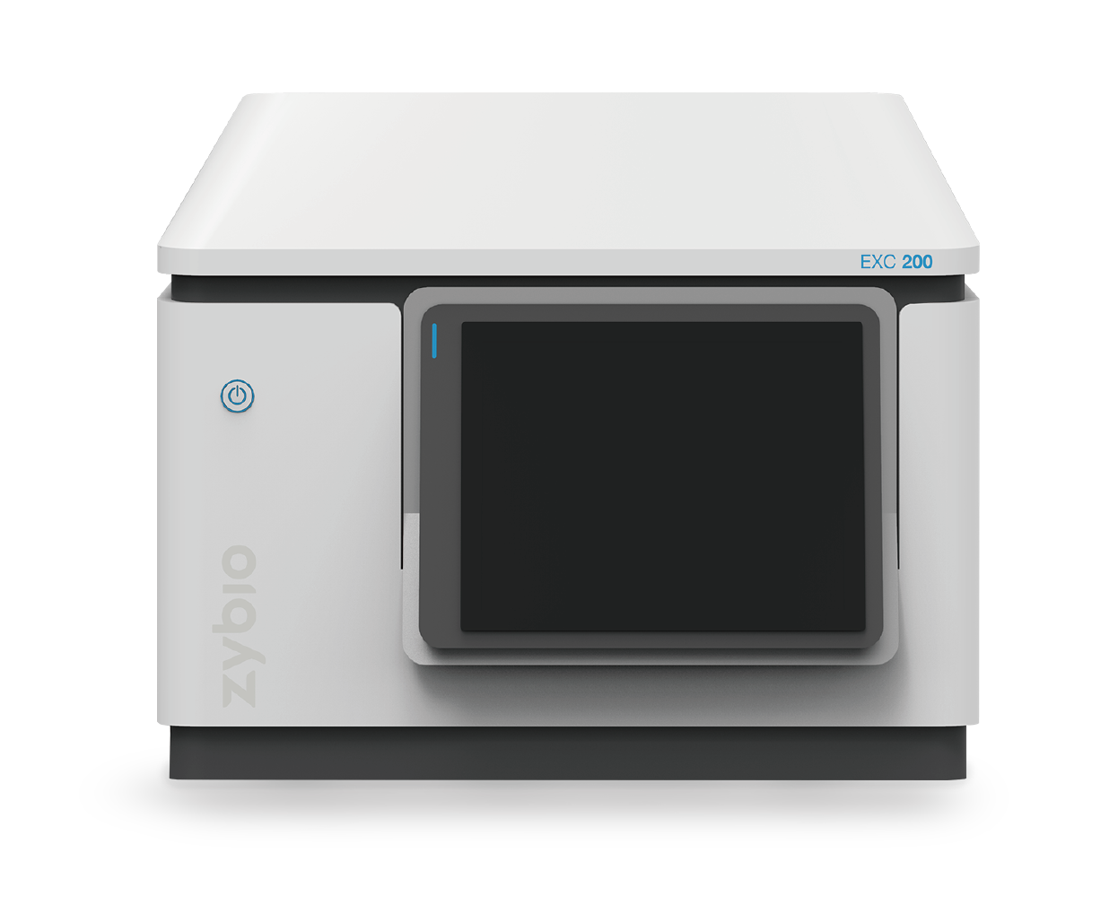
EXC200
A cost-effective choice for clinical laboratories

Slide 2
Contents
01 Overview
02 Analysis Principle
03 Installation
04 Maintenance
05 Mechanical Structure
06 Hydraulic System
07 Trouble Shooting

Slide 3
01
Overview

Slide 4
EXC200 introduction
Overview
Fully automatic desktop biochemical analyzer

Slide 5
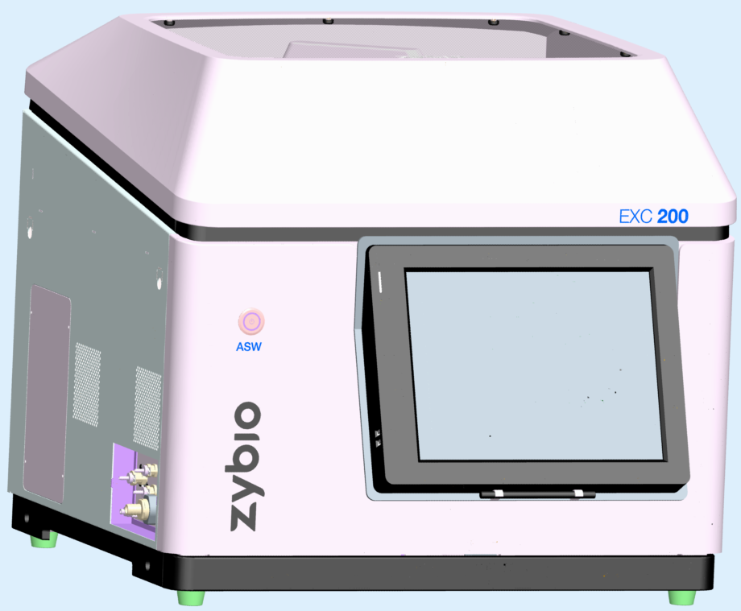
Mechanical Structure
Instrument front view
Top panel
Indicator
Analysis switch
Touch screen
Front screen USB port
Touch Pen

Slide 6
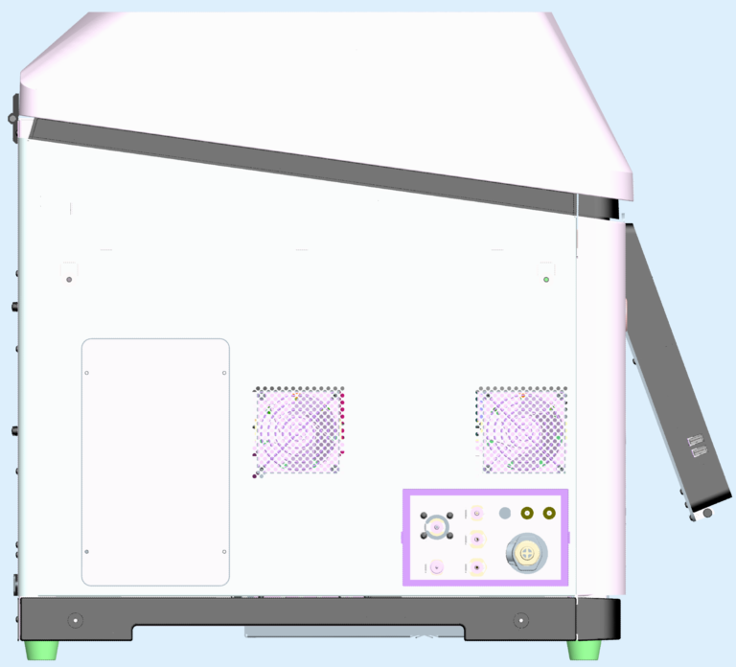
Mechanical Structure
Instrument left view
Cooling fan outlet
Syringe maintenance wicket
Inlet/outlet & sensors of external liquid
Carrying handles
Notes:
wicket/ˈwɪkɪt小门

Slide 7
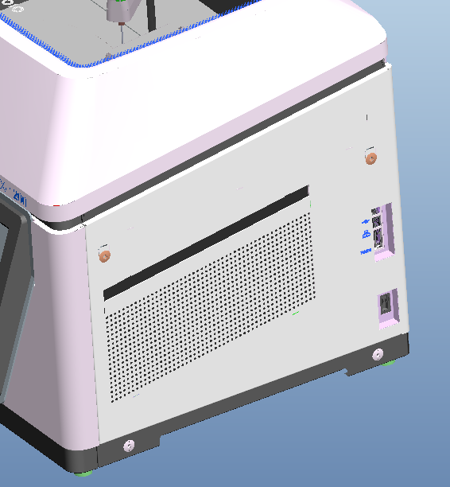
Mechanical Structure
Instrument right view
LAN port, USB port and serial port
Main switch
PCB board cooling inlet

Slide 8
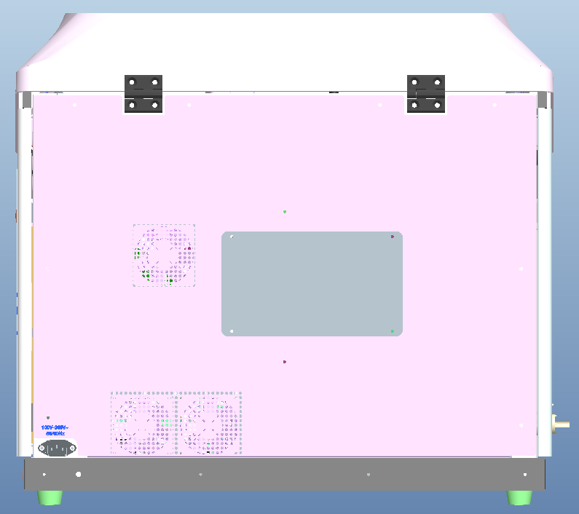
Mechanical Structure
Instrument rear view
Main cooling outlet
Rear maintenance wicket
Power supply cooling outlet
Power socket

Slide 9
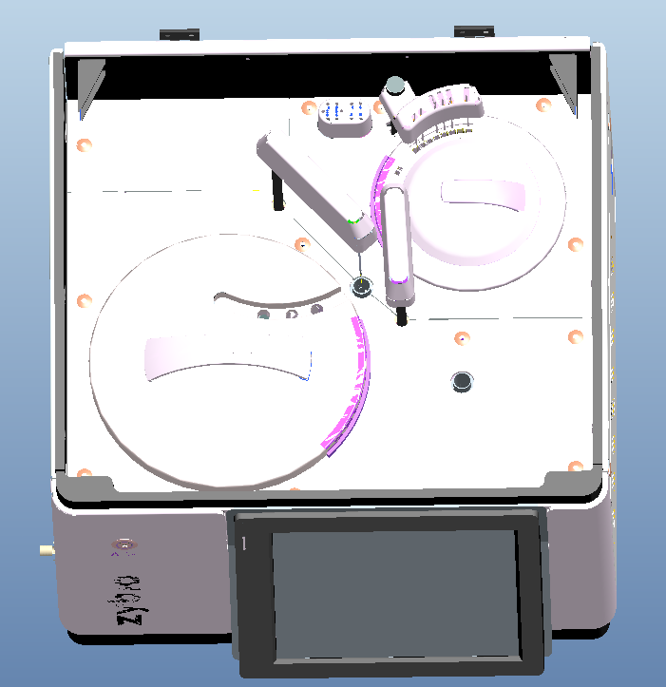
Mechanical Structure
Instrument top view
Washing station
Reaction disk
Reagent/Sample probe
Stirrer
Wash pool
Reagent/Sample disk
Notes:
Lift top cover, we can see the top view like this.bidirectional

Slide 10
Overview
Overview
Throughput: 240 T/H for single reagent; 160 T/H for double reagents
Random access, STAT function
Water consumption: 5L/H
Advanced rear spectrophotometry, (340-800)nm, in total 12 wavelengths
Open system
Bilateral LIS connection
Notes:
Unilateral /ˌjuːnɪˈlætrəl/单向的，现在支持双向的？consumption/kənˈsʌmpʃn/ spectrophotometry/ˌspektrəʊfəʊˈtɒmɪtri/
The instrument can support stat function. It means If there are emergency samples,
Adopt采用

Slide 11
Overview
Overview
Multiple sample type: Plasma, Serum, Urine and CSF
Reagent: ready for use
Sample positions : 40（including STAT positions）
Reagent positions: 40
Cuvettes: 63
Sample volume : 2μl-50μl
Minimum reaction volume: 90μl
Reaction temperature: 37±0.2℃
Notes:
STAT急诊样本周转时间sample turnaround time
There are 63 cuvettes for reaction.
serum/ˈsɪərəm/血清 plasm/ˈplæzmə/
Volume can be as low as 90ul

Slide 12
Overview
Overview
Basic Principle : Colorimetric assay ; turbidimetry
Test Method : End-point assay, Fixed time assay
Kinetic assay(rate assay)
Software operation : Win 10
Dimension(mm) : 710mm*705mm*635mm
Weight : ＜75kg
Power Supply : 100-240V, 50/60HZ
Power：<500VA
Notes:
turbidimetry/ˌtɜːbɪˈdɪmɪtrɪ/比浊法 assay/əˈseɪ/ Kinetic /kɪˈnetɪk/
功率有20%会被消耗（ups推荐）

Slide 13
Overview
Testable items
Liver function(19)
Cardiac Markers(8)
ALT AST ALP ALB TP TBIL DBIL GGT TBA ADA PA CG CHE 5’-NT AFU mAST GLDH LAP MAO
LDH LDH1 CK CK-MB α-HBDH MYO cTnI IMA
Renal function(11)
Cardiovascular(5)
UREA UA CREA CysC RBP α1-MG UTRF β2-MG
NGAL NAG mALB
ACE hs-CRP HCY MPO MP-PLA2
Blood lipid(10)
Rheumatism(3)
CHOL TG HDL-C LDL-C ApoA1 ApoB ApoE Lp(a)
sdLDL-C NEFA
ASO RF anti-CCP
Glucose homeostasis(7)
Ion(7)
GLU HbA1c GSP GA LAC β-HB Insulin
Ca Mg P CO2 Fe Zn Cu
Notes:
Rheumatism/ˈruːmətɪzəm/风湿类
The machine has the following 70 testable items. renal/ˈriːnl/

Slide 14
02
Analysis Principle

Slide 15
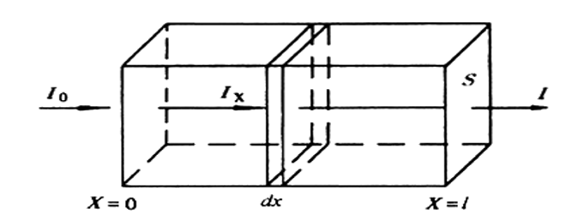
Analysis principle
Lamber-Beer law ：Fundamental law of absorption spectroscopy
Lamber law ：A∝l，A ∝C
A=lg(1/T)=lg(I/I0)= ε b c
A beam of light passes through a reaction system, get absorbance “A” , “A” is proportional to the thickness of the absorption layer , and also the proportional to the concentration of reaction solution.
Notes:
Absorbance is proportional to concentration absorption /əbˈzɔːpʃn; əbˈsɔːpʃn/

Slide 16
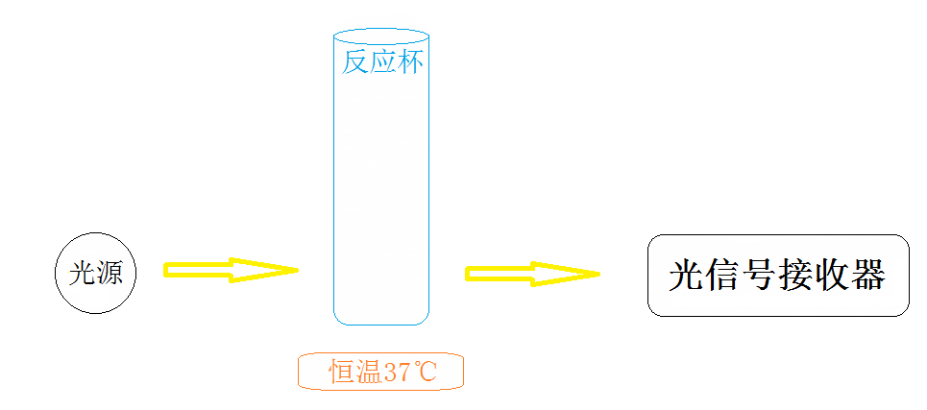
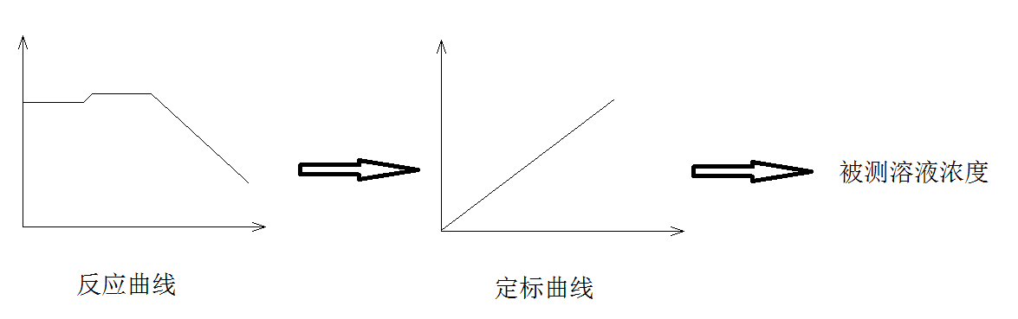
Analysis principle
Principle and analysis steps
LED
Photometer
cuvette
37℃
co
concentration
Reaction curve Calibration curve
Notes:
Photometer

Slide 17
03
Installation

Slide 18
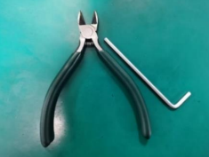
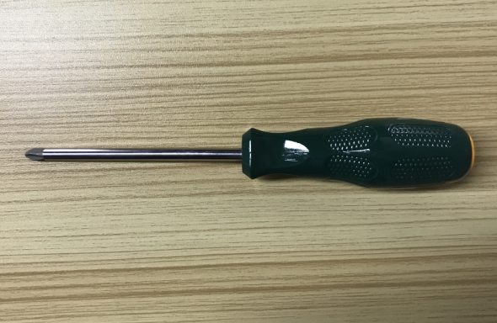
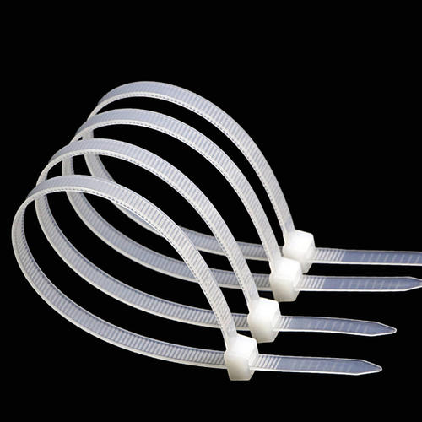
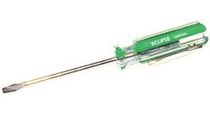

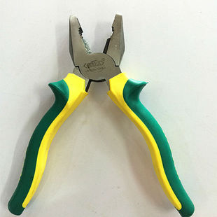
Installation guide
Pre-installation preparation
Installation tools
Allen wrench
Scissor
Cross screwdriver
Straight screwdriver
Fixing belt (4x150mm 10 strips)
Gloves
Pincer pliers
Notes:
Scissor /ˈsɪzə(r)/剪刀 Pincer pliers老虎钳

Slide 19
Installation guide
Environment requirements
Operating conditions
Ambient temperature range:10℃～30℃
Relative humidity range:30%～85%, no condensation
Atmospheric pressure range:70.0kPa～106.0 kPa
Stay away from magnetic interference
Avoid direct exposure to strong light
Good grounding environment(0-5V)
The installation table or ground should be flat （Slope ＜ 1/200）
Altitude:＜ 3000 meters
Pollution rated degree: Level 2
Indoor use only
The installation table should bear a weight of at least about 100kg
Good ventilate
Dust-free environment
Be away from heating and windy outlet
No corrosive and flammable gas
No vibration on the table (or ground)
No loud noise and power interference
If room temperature out of requirements, air conditioners needed

Slide 20
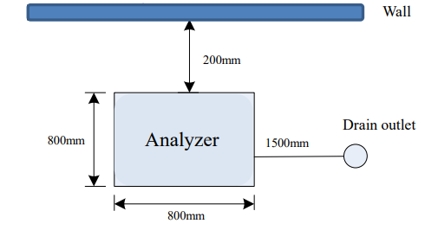
Installation guide
Environment requirements
Space requirement
Please install the instrument as space requirement of below figure:
≤
Notes:
The longer of the tube length, the bigger of the clog possibility

Slide 21
Installation guide
Environment requirements
Power and grounding
AC 100-240V, 50/60HZ, Good Grounding (Grounding resistance ＜ 10mΩ )
Power input: ≤500VA
Please grounding power supply correctly. Incorrect grounding may cause electric shock, hardware damage, and instrument failure.
(0<U<5 v)
Notes:
交流电 (Alternating Current)

Slide 22
Installation guide
Water supply requirements
General requirements
Water quality should meet the requirements of CLSI Grade II water; resistance is greater than 1MΩ. CM, the silicate content is less than 0.1mg/L;
Water supply: not less than 5L/h;
Temperature: Water temperature 5-32°C.
Water supply method
Built-in water inlet pump: Supply instrument water via water inlet pump, external water source cannot be under pressure.
Water supply tank cannot exceed the height of water inlet of analyzer, and the length of water pipe should not exceed 1.5 meters.
Notes:
abbreviation/əˌbriːviˈeɪʃn/ 缩写 via /ˈvaɪə/ exceed/ɪkˈsiːd/ silicate /ˈsɪlɪkeɪt/硅酸盐
If the tank over the analyzer’s height, it will make the pump under pressure which may damage the pump.

Slide 23
Installation guide
Drainage requirements
General requirements
The waste tube should place without bending or protrusion
The waste liquid discharge cannot be blocked
Waste discharge method
Connect waste tank: The waste tank must be lower than instrument placed level, ensure the waste tank cap is lower than waste outlet of the instrument.
Connect the waste tube: The distance between waste tank port and instrument discharge port should not exceed 1.5 meters, the waste tube shall not be laid flat on the same level as the drainage outlet of instrument.
Notes:
protrusion/prəˈtruːʒn/突起 drainage/ˈdreɪnɪdʒ/排水
The instrument mainly uses gravity to discharge the waste liquid

Slide 24
Installation guide
Instrument installation
Unpacking Check
Check all the packing cases before unpacking, include: 1 tank case, 1 concentrated detergent case, 1 instrument wooden case (Note: There are 3 accessory packages in the wooden case).
All the instrument packages had passed strict inspection by Zybio company before transportation. After you receive the instrument, please check the items carefully as below before opening the box:
1. If outer packing has inverted or deformation, if tilting prevention label turn red or not.
2. If outer packing has obvious marks of wet water or not.
3. If the outer packaging is obviously impacted or not.
4. If the package has been opened or not.
5. Check appearance of all devices carefully, to see if have cracks, bruises or deformation or not.
If find any abnormal sign please take photo or video of it, then contact assigned engineer of Zybio.
Notes:
Tilting倾斜 bruises /ˈbruːzɪz/

Slide 25
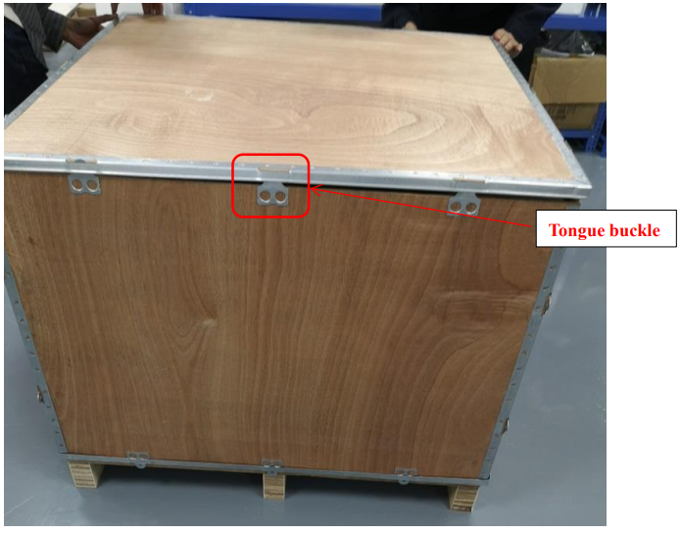
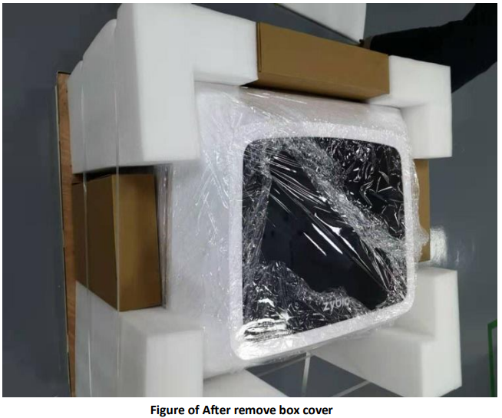
Installation guide
Instrument installation
Unpacking
1. Push the wooden box to a suitable position, ensure there is enough space to open it. And ensure there is enough space for two people to lift out the instrument.
2. Wear protective gloves, disassemble the tongue buckle (by a vise) which connecting upper cover & side plate. Remove the upper cover of the wooden box, then remove the front side panel—left side panel—rear side panel—right side panel, remove fixing tape. Take out all foam and accessory box.
If find any abnormal sign please take photo or video of it, then contact assigned engineer of Zybio.
Notes:
tape /teɪp/胶带 tongue/tʌŋ/ vise /vaɪs/老虎钳
The gloves can protect us from being scratched by sharp wooden or metal surface.

Slide 26
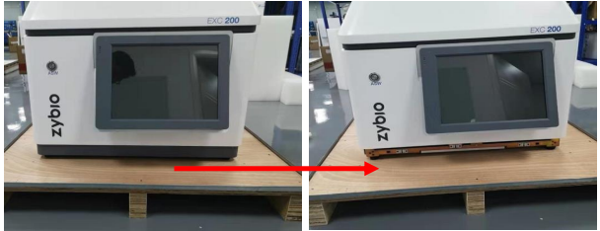
Installation guide
Instrument installation
Unpacking
3. Remove instrument PE bag, take out desiccant, remove trim strip from instrument front case.
Notes:
trim strip/trɪm strɪp/ 压条
desiccant/ˈdesɪkənt/ 干燥剂

Slide 27
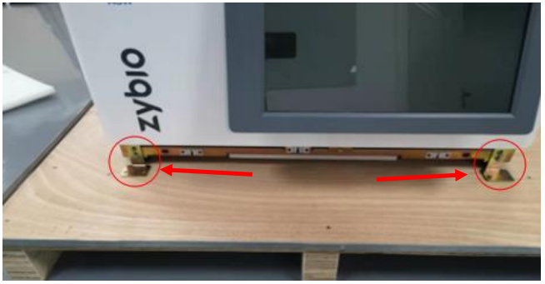
Installation guide
Instrument installation
Unpacking
4. Remove fixing bracket, unscrew M8×35 Allen screws of four fixing brackets (at the bottom) by M8 Allen wrench. Then unscrew 2 M4×10 Allen screws on the side of the fixing bracket by M4 Allen wrench, then take out the fixing bracket.
Notes:
Remove 6 screws then take out the fixing bracket.

Slide 28
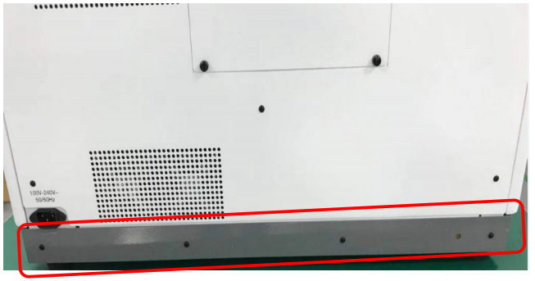
Installation guide
Instrument installation
Unpacking
5. Carry and placing the instrument on work table gently, pay attention to safety.
6. Install back the front trim strip to the front panel of instrument. Then take out the rear trim strip from foam, install it by M3x8 cushion screw (which place in accessories box #3).

Slide 29
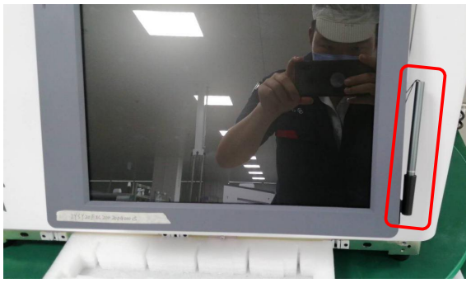
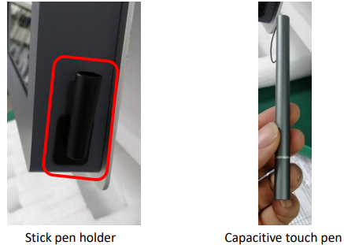
Installation guide
Instrument installation
Unpacking
7. Take out the capacitive touch pen from accessory box# 3 and stick the pen holder on the right side of monitor, then place the capacitive touch pen in the pen holder. Figure shown as below:

Slide 30
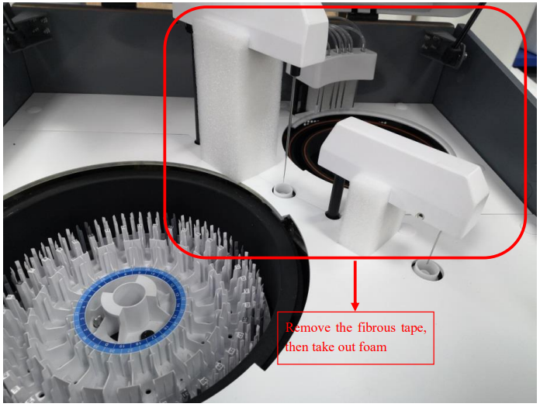
Installation guide
Instrument installation
Open the upper cover of instrument, remove the adhesive tape & the protective foam of needle module & Stirring rod gently (Stirring rod come first)
Notes:
adhesive/ədˈhiːsɪv; ədˈhiːzɪv/粘着的 Stirring/ˈstɜːrɪŋ/ tape /teɪp/ fibrous /ˈfaɪbrəs/纤维的

Slide 31
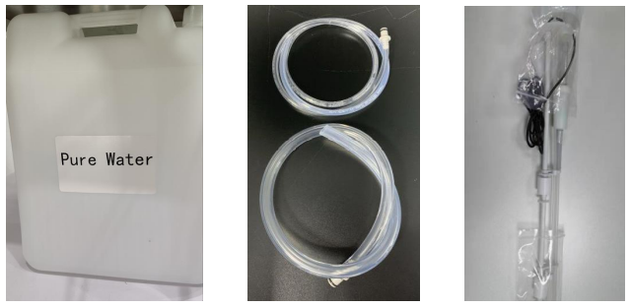
Installation guide
Whole machine connection
1. Take out the purified water tank from waste tank packing box, take out C043 and C046 labeled pipeline from Accessory box #3; and take out purified water tank floater assembly from Accessory box #2;
Purified water tank
Tube of purified water
Inlet float sensor

Slide 32
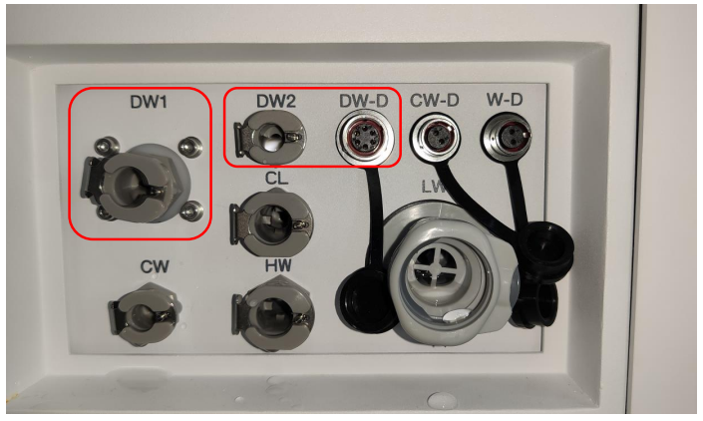
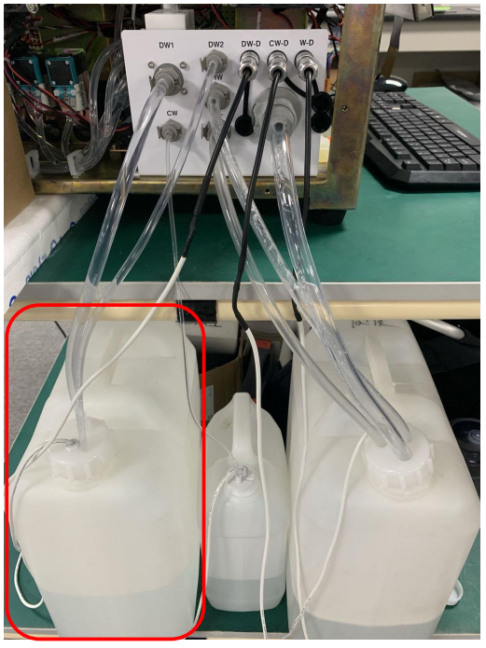
Installation guide
Whole machine connection
Pipeline connection on the left of the instrument is shown in the figure as below:
2. Fill the purified tank with purified water, place it under analyzer.
Note: The purified water tank can’t place on the table of analyzer; insert C043 labeled tube into "DW1" connector of analyzer, insert C046 labeled tube into "DW2" connector of analyzer. Connect the other end of these two tubes to purified water tank cap according to diameter size, then tighten the cap of purified water tank, insert the float sensor to "DW - D" connector.
C046
C043

Slide 33
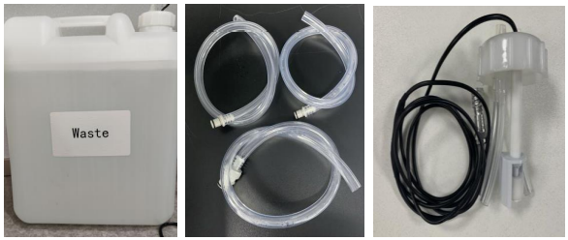
Installation guide
Whole machine connection
3. Take out waste tank from waste packing box, and take out C051, C053, C055 labeled tube from Accessory box #3. Take out the waste tank float assembly from Accessory box #2;
Waste tank
Waste Tube
Waste float sensor

Slide 34
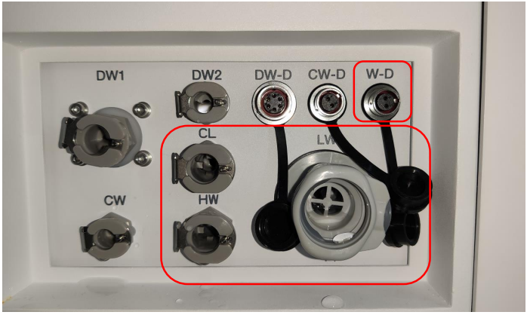
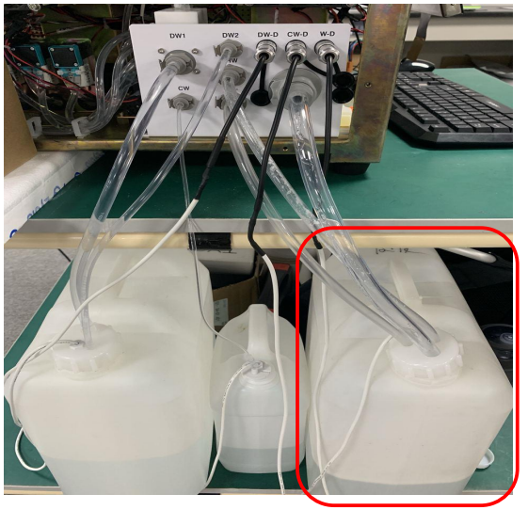
Installation guide
Whole machine connection
4. Connect C051 labeled waste tube to "LW" quick-plug connector, connect C053 labeled waste tube to "HW" quick-plug connector, connect C055 labeled waste tube to "CL" quick-plug connector.
C055
C051
C053

Slide 35
Installation guide
Whole machine connection
5. Drain Waste Method 1: If there is a sewage outlet for waste liquid, connect the waste liquid drain pipe to the corresponding joint on the side of the instrument, and insert the other end of the waste liquid pipe directly into the sewage outlet for waste liquid (length of the pipeline shall be cut according to the distance);
Drain Waste Method 2: If there is no sewage outlet for waste liquid, tighten liquid float assembly on the waste tank, connect float sensor cable to W–D connector, and insert other end of those three waste liquid pipe to waste tank accordance with pipeline diameter respectively (length of the pipeline shall be cut according to the distance, pipe C051 can’t be bent directly or in u-shaped bending, otherwise it will lead to liquid seal, then cause waste liquid flow backward).
Notes:
sewage/ˈsuːɪdʒ/污水 diameter直径

Slide 36
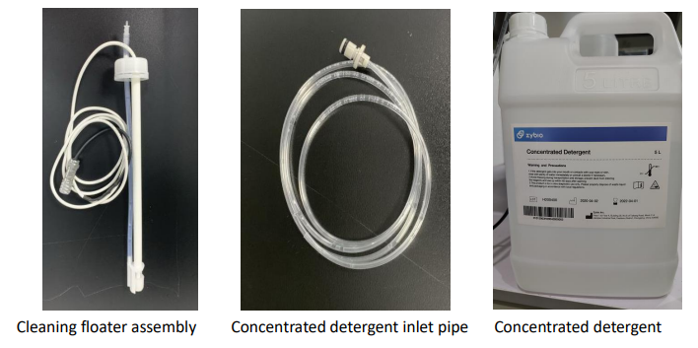
Installation guide
Whole machine connection
6. Take out concentrated detergent from cleaning packing box, take out C048 labeled pipe from Accessory box #3; take out its float sensor assembly from Accessory box #2.

Slide 37
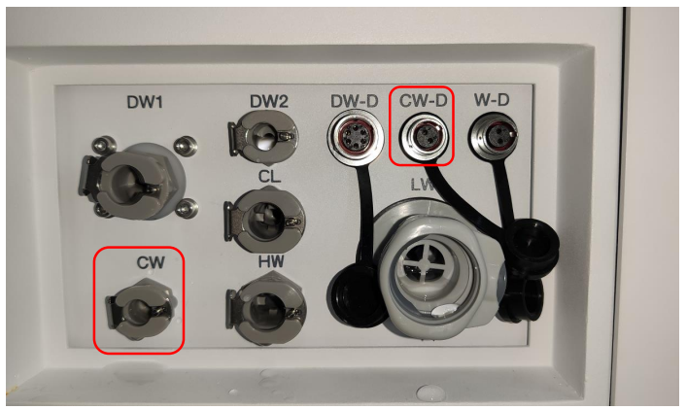
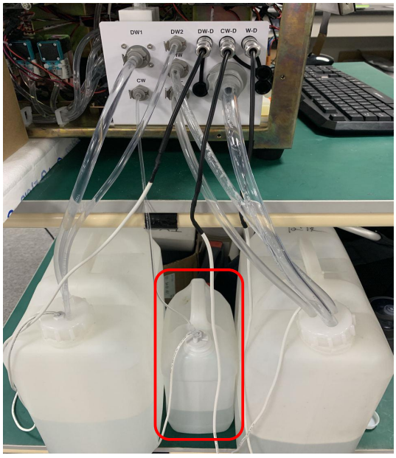
Installation guide
Whole machine connection
7. Connect the float sensor and pipeline to the "CW-D" connector and "CW" quick-plug connector on left side of the instrument, screw the Concentrated detergent float sensor into the bottle.

Slide 38
Installation guide
Whole machine connection
8. Pipeline connection:
Label | Signification | Function
DW1 | Distilled water | Distilled water inlet, supply distilled water For instrument
DW2 | Distilled water | Connected to distilled water suction tube, flow back distilled water automatically
CW | Concentrated detergent | Connect to concentrated detergent tube, supply Concentrated detergent
HW | High concentration waste | Drain waste for reaction cuvette
CL | Condense water | Drain condense water for reagent disk
LW | Low concentration waste | Drain waste for wash pool
DW-D | Distilled water float sensor | Distilled water level detection
CW-D | Concentrated detergent float sensor | Concentrated detergent level detection
W-D | Waste liquid float sensor | Waste liquid level detection

Slide 39
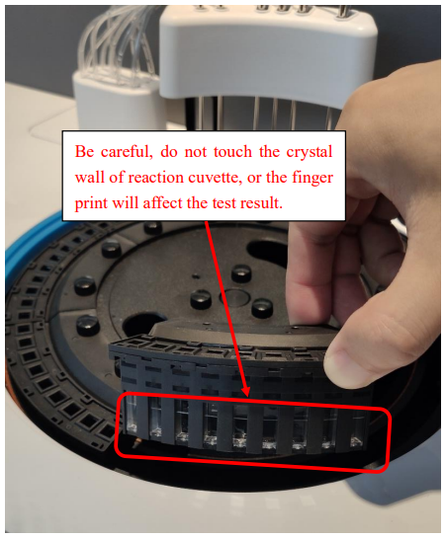
Installation guide
Whole machine connection
9. Take out 7 sets of reaction cup assembly from the accessory bag (1 extra set for backup). Be careful, do not touch crystal of the reaction cup; Press the reaction cup assembly on the reaction plate body, and then fix the reaction cup assembly on the reaction tray main unit with 14 thumbscrews, picture as on the right.
Notes:
thumscrew/ˈθʌmskruː/

Slide 40
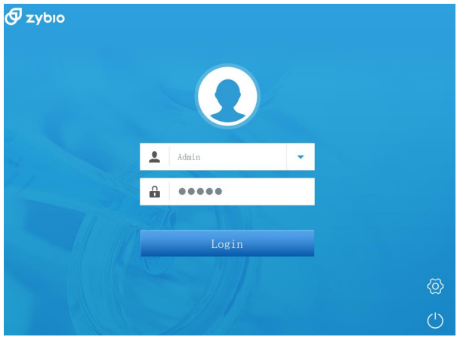
Installation guide
Whole unit test
Bootup initialization
1. Before starting up, confirm that purified water tank and concentrated detergent tank are full, then waste liquid tank is empty.
2. After confirmation, turn on the main power switch on the right-side panel of instrument, then turn on the analysis switch on the front panel, and waiting around 45 seconds.
3. Log in with authority:
User name: Engineer
Password: zybio888
wait several minutes for initialization.

Slide 41
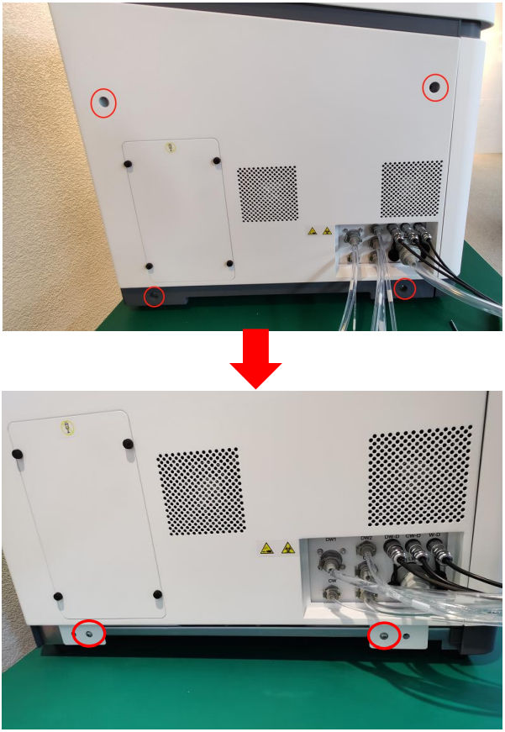
Installation guide
Whole unit test
Exclude bubble and hydraulics priming
1. After log in, first please disassemble the left-side panel by removing 6 screws at these 6 positions in the picture on the right.

Slide 42
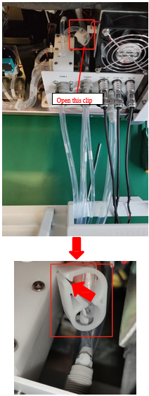
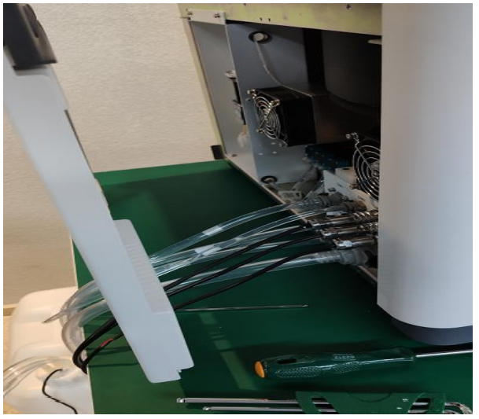
Installation guide
Whole unit test
2. No need to unplug the pipeline on the left side panel, just open left-side panel to make your hand can reach and open the clip on the C011 pipeline. Please see the figure on the right:

Slide 43
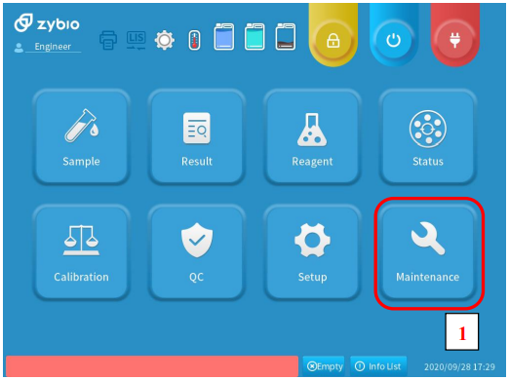
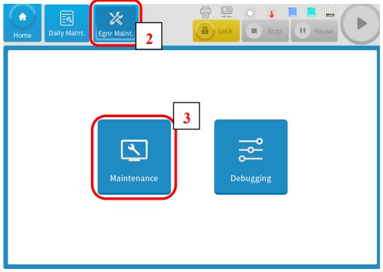
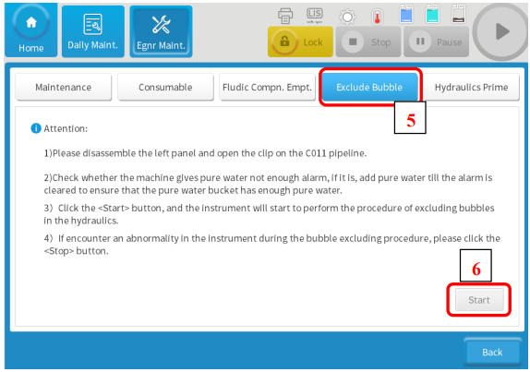
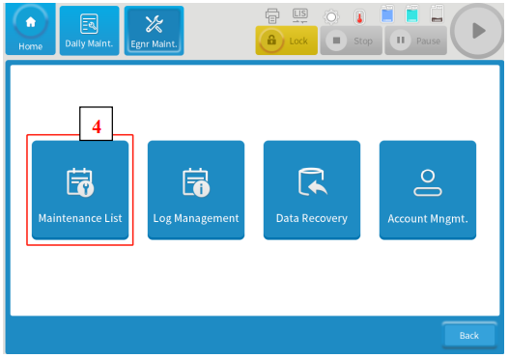
Installation guide
Whole unit test
3. Go to [Maintenance]➔[Engineer Maintenance]➔[Maintenance]➔[Maintenance List]➔[Exclude Bubble], ensure purified water tank remaining sufficient water, and then click [Start] to procced the bubble excluding procedure.

Slide 44
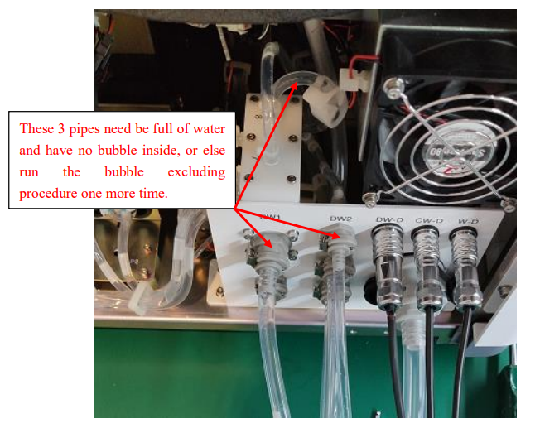
Installation guide
Whole unit test
4. After confirm the clip is opened, click [OK] to start procedure, and wait the next prompt pop up on the screen. After the next prompt pop on the screen, please check if the pipe connect to DW1 port ＆ the pipe connect to DW2 port ＆ the pipe related to the clip are all full of water and no bubble. If there is bubble, please check if any of these 3 pipes is loose or cracked, run the bubble excluding procedure one more time.
Notes:
prompt/prɒmpt/

Slide 45
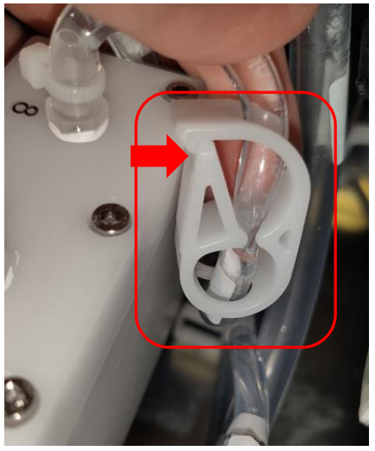
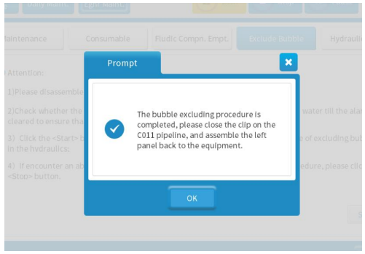
Installation guide
Whole unit test
5. After checking, follow the prompt to close the clip on the C011 pipeline, and click OK.

Slide 46
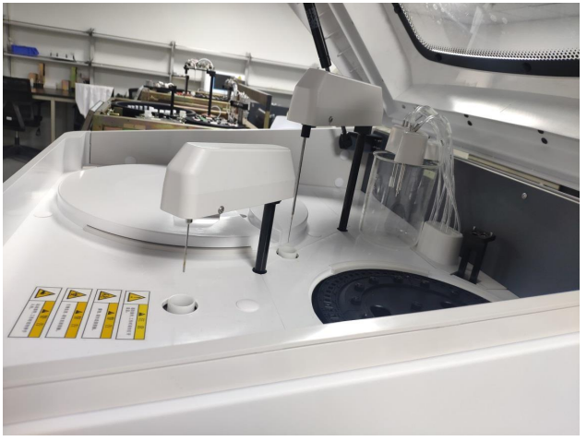
Installation guide
Whole unit test
6. After bubble excluding and close the clip on the C011 pipeline, assemble back the left-side panel.
7. Please disassemble the wash station and put the cleaning needles to a beaker or clean container which capacity no less than 250ML, please refer to the following picture. In the next procedure, all the needles of wash station will dispense water continuously.
Notes:
Beaker烧杯

Slide 47
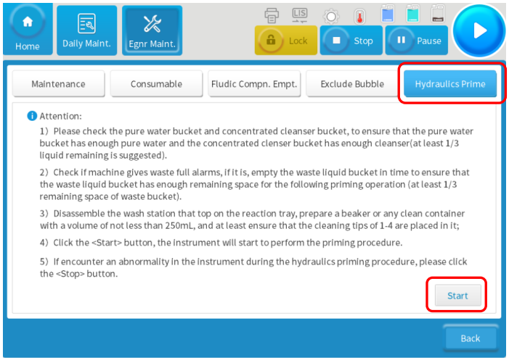
Installation guide
Whole unit test
8. Click Hydraulics prime: Ensure the purified water and concentrated detergent sufficient, ≥1/3 remaining. Ensure the waste tank has enough cubage for the following priming procedure. After checking, click [start] and confirm [OK] to wait 2 minutes till next prompt pop up on the screen.
Notes:
cubage/ˈkjuːbɪdʒ/容积 one third

Slide 48
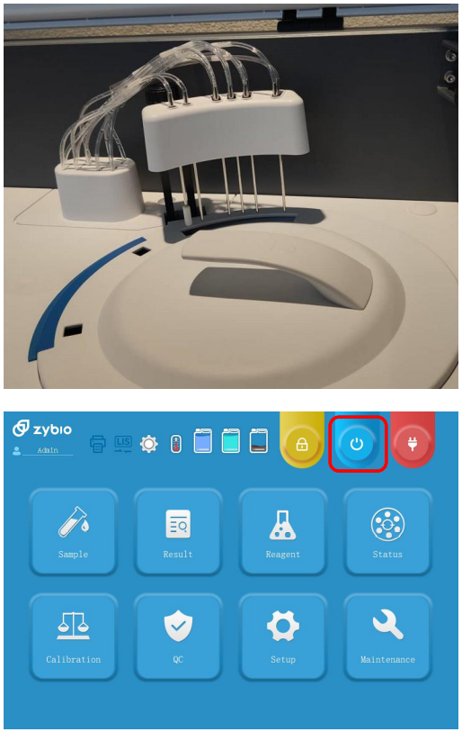
Installation guide
Whole unit test
9. After Hydraulics priming, please assemble back the wash station. Turn off the machine and restart the machine again under Admin authority.

Slide 49
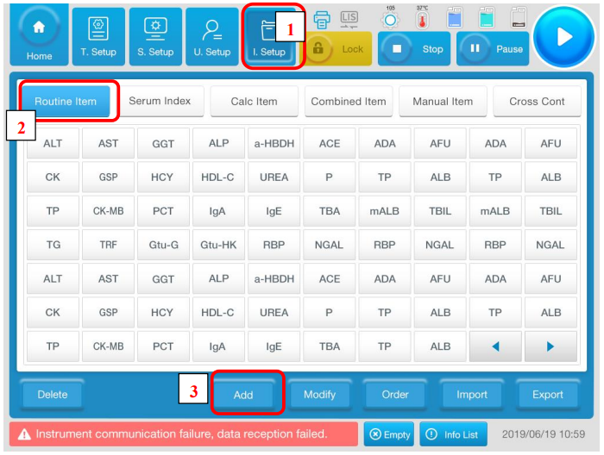
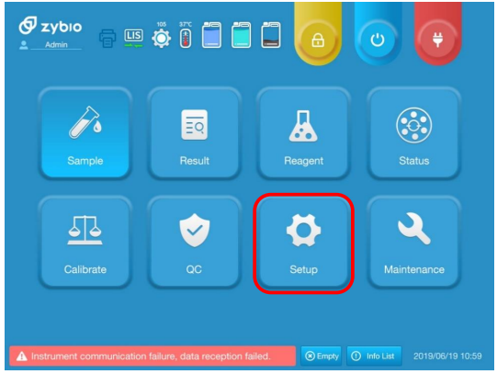
Item parameter setup
Log in and get into software interface.
Click the corresponding button following the numerical order as shown in the picture.

Slide 50
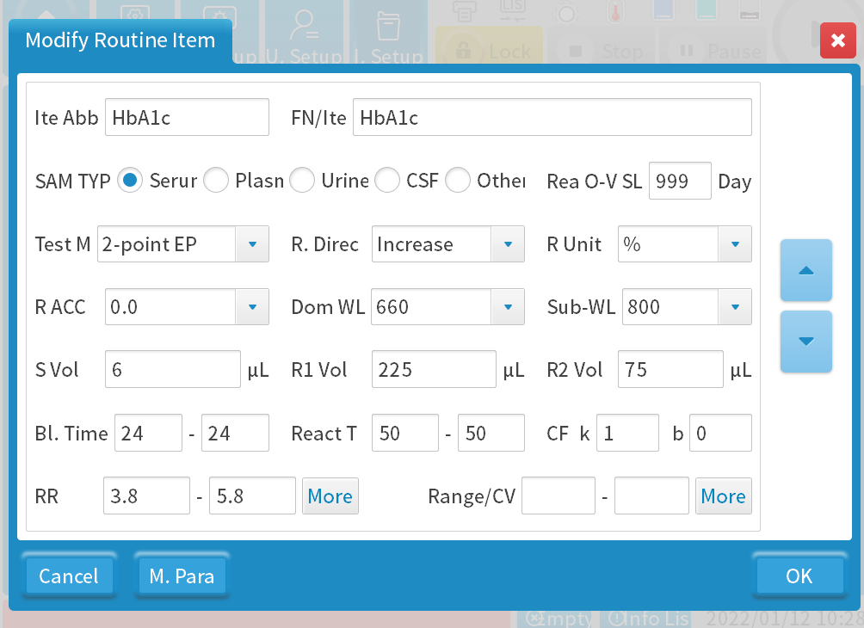
Item parameter setup
Input item information according to IFU of reagent.
Refer to the documentation EXC200 Item Setting Guide to set these parameters.
The accuracy is determined from the values of the linear range. Usually, the number of decimal places is one more than the linear range.
Notes:
I will take our reagent as an example to explain how to set parameters and do calibration.

Slide 51


Item parameter setup
Choose Linear for two-point calibration. It means if there are two calibrators, choose linear.
Choose Spline for more than two-point calibration. It means if there are more than 2 calibrators, choose spline.

Slide 52



Reagent position setup
Every tray has 20 positions. You can choose another when you run out of one tray.
Input reagent information according to IFU of reagent.

Slide 53


Reagent position setup
The outer circle position is for R2. Generally, for convenience, we can put R2 next to R1.
The inner circle position is for R1.
R2
R1
Select the position on Reagent/Sample tray.

Slide 54



Calibration
Click the corresponding button following the numerical order as shown in the picture.

Slide 55



Calibration
Input calibrator name.
Input associated test items of calibrator, then click [Save].
Generally, recommend you choose calibrator position on Tray NO.5.

Slide 56




Calibration
Set the calibrator concentration according to the calibrator specification (concentration parameter), and then click [Save].
As many calibrators as there are, we need to add the corresponding number of calibrators. For example, there are five calibrators, we need add five calibrators.

Slide 57

Calibration
If there is one calibrator for the item, we need add water as one calibrator. It’s concentration is 0.

Slide 58


Calibration
Choose the corresponding tray of sample and reagent, select calibrating item, and then click [Apply].
Click it to start test.
When finish the application, view Application checklist in application list interface.
Note: Place the calibration reagent in the position which has been set, ensure corresponding reagent volume are sufficient and sample/calibrator volume must be more than 200 ul.

Slide 59

Calibration
1
2
Finish test running, click [Cal R] to enter the calibration results research interface to check calibration results, select relevant date, item then click [C. Curve] to check the calibration curve.
3

Slide 60


Calibration
Remember check the blank, otherwise you can’t select these buttons.

Slide 61


QC
Click [QC]=> [QC Setup] => [Ad QC S] on the main interface.

Slide 62

QC
For the QC position, recommend select the same tray with calibrator.
Input QC data according to QC instruction, select position and relative item, click [Save] to finish.

Slide 63

QC
Set mean value and standard deviation of QC (for which include item and methodology in detailed) according to the packing insert of QC, then click [Save] to finish setting.

Slide 64


QC
Click the corresponding button according to the numerical sequence.

Slide 65

QC
Click [QC App], choose item name, and then click [App] to apply this item.
And can view the application list by click [APP List] button.
Place QC reagent in set position, and ensure sufficient volume for corresponding reagent.

Slide 66

QC
Finish QC test running, click [QC] in main interface=> [L-J Curve] to check the QC curve.

Slide 67

Sample test
Finish sample test, view the results in [Result] interface.
For the sample position, recommend select the same tray with calibrator, so they can run together.
Input the patient information
select testing item
Apply the items for this sample, confirm item name and relevant reagent position are well set.

Slide 68

Sample test
Choose the set calibrator/QC/sample tray, remember the reagent tray you just set and select it.
Click start button, we can get this interface.
Choose it, the machine will do all the test on the tray you select.
You can also choose the specify position on the tray.

Slide 69


Sample test
Tips: Click option could select how many times repeat for this test, it can help check the repeatability for this item.
Tips: Calibration, QC, sample test can be applied together, then run together in one batch.

Slide 70
04
Maintenance

Slide 71
Maintenance
Maintenance
Clean reagents/serum drops on the analyzer surface timely. In order to ensure the performance of instrument, it is recommended to perform daily, weekly, monthly, quarterly, semi-annual, and annual maintenance as following table:
Daily:
Clean the instrument surface , confirm tubing connections of purified water tank & cleaning solution tank & waste liquid tank
Check whether reagent/sample probe, cleaning needle, plunger pump leaking
Check whether relevant probe/needles liquid input/output normally, check and clean the wash pool
Weekly:
Intensive cleaning
Clean the reagent/sample disk
Check and clean exterior of cleaning needle & stirrer
Reaction cuvettes (dirty) detection- cuvettes contamination detection (include light source detection)
Monthly:
Clean reagent/sample probe, cleaning needle, stirrer and wash pool
Note: Clean all exterior of probe/needles by a dust-free cloth dipped with alcohol
Notes:
plunger /ˈplʌndʒə(r)/
Execute intensive cleaning procedure.

Slide 72
Maintenance
Maintenance:
Quarterly :
Clean all fans, clean air strainer
Cleaning purified water filter
Clean the inlet/out of fluid confluence module
Cleaning the tubing of cleaning needles to the fluid confluence module
Check whether cuvettes scratched or dirty, and clean inwall and outwall of cuvettes
Check whether the lamp is normal
Check whether the screwed connectors of probe or plunger pump are loosen
Check whether there are bubbles on the glass tube of plunger pump
Check whether reagent / sample probe & cleaning needle blocked
Clean and lubricate guide shaft, spline shaft of reagent / sample probe & stirrer
Clean and lubricate driving guide rail of cleaning needle, guide shaft of sample plunger pump and screw rod
Check reaction curves of sample test, rerun calibration and quality control
Notes:
confluence module汇流块 stirrer /ˈstɜːrə(r)/ rod/rɒd/

Slide 73
Maintenance
Maintenance:
Half yearly:
Clean the reaction cuvette holder
Instrument internal and all sensors dust removal
Replace peristaltic pump head
Change lamp(Light source)
Replace purified water filter
Replace reaction cuvettes (plastic cuvettes), soak and clean inwall & outwall of reaction cuvette
Cleaning purified water tank
Cleaning the branch waste tube and general waste tube of wash pool
Cleaning the inlet of purified water
Yearly:
Replace aspirating tube and draining tube of wash station
Replace aspiration tubing of purified water(include tubing of float sensor)
Replace the branch waste tube and general waste tube of wash pool
Notes:
peristaltic/pəˈrɪstæltɪk/蠕动的

Slide 74
05
Mechanical Structure

Slide 75
Mechanical Structure
Functional modules
EXC200 analyzer functional modules include：
Reaction disk
Reagent/Sample disk
Stirrer
Wash pool

Slide 76

Mechanical Structure
Washing station
Reagent/Sample probe
Reaction disk
Stirrer
Optical module
Reagent/Sample disk

Slide 77
Mechanical Structure
Reaction disk module include:
Reaction disk
Reaction cuvettes
Temperature control slot

Slide 78

Mechanical Structure
Key point ：
Positioning accurate of main disk assemble
Fixing screw
Main Disk
Locating pin
Cuvettes mounting rack
Temperature control slot
Notes:
比色皿装配架 14 fixing screws

Slide 79

Mechanical Structure
Reaction Disk ：
Function：Placing the reaction cuvettes and transferring the reaction cuvette to corresponding positions(Reagent, sample, mixing, washing position)
Feature ：
Disk structure , only rotate in anti-clockwise
Reaction Disk handle position
Rotating mechanism
Home position sensor
Conveyor belt
Motor
Notes:
Lower computer 下位机

Slide 80

Mechanical Structure
Cuvette clamp
Cuvette
Cuvette holder
Rotary knob
Main disk
Notes:
rotary /ˈrəʊtəri/旋转转动的disassemble /ˌdɪsəˈsembl/ the reaction disk,

Slide 81

Mechanical Structure
Reaction cuvette ：
Function： As a container for reaction and colorimetric measurements, totally 63 positions;
Feature ： Ultraviolet quartz cuvettes , good transmittance, reusable;
Key point ：
Cuvette illuminating surface free from scratch, dirt and so on
Notes:
There are two main types of cuvette , one is plastic cuvette, the other one is quartz. For quartz cuvette, it can be used for a long time until it’s broken. For the plastic cuvette, it need to be replaced after using 2-3 months.
Quartz /kwɔːts/ use it until it broken. and plastic2-3month to replace

Slide 82
Mechanical Structure
Reagent/Sample disk include:
Reagent/Sample disk
Cooling system
Reagent/sample probe
Reagent/sample Liquid injection module

Slide 83

Mechanical Structure
Reagent/Sample disk ：
Function ：
Loading reagent bottles/sample tubes
Transfer reagent bottle/sample tubes to sampling positions
Feature ：Sample and reagent are loading in one disk, and adopt disk type structure design.
Specification:
Outer circle for sample position, 40 in total ; Middle & inner circles for reagent, 40 in total(middle & inner circle 20 positions for each)
Key point : Assemble positioning accurate
Reagent/Sample disk
Motor

Slide 84

Mechanical Structure
Lock button
Reagent position
Reagent position No.
Sample position No.
Locating pin
Sample position
Notes:
planform

Slide 85

Mechanical Structure
Cooling system：
Function ：
Ensure reagents in a low temperature environment to keep reagent in good performance and reduce it volatilization
Feature ：
Air cooling, stable, 24 hours non-stop refrigerating, low failure rate and low maintenance cost
Reagent/Sample disk
Cooling plate
Cooling fin
Air flue

Slide 86

Mechanical Structure
Reagent/sample probe module：
Function: Aspirate reagents/samples from reagent bottle/sample tube, and then dispense to quartz cuvettes (colorimetric cuvettes)
Vertical anti-collision: Detect whether any obstacles in the vertical direction or not. If there is a collision, the automatic protection system will be enabled to prevent reagent/sample from damage.
Liquid level detection and volume tracking: Detect the liquid level in the sample tube automatically and determine depth of the descend according to the volume of liquid aspiration
LLD board
Rocker
Reagent/sample probe
Spline
Left/right rotating mechanism
Up/down movement module
Notes:
LLD means liquid level detection.

Slide 87

Mechanical Structure
Reagent/sample plunger pump：
Function:
Aspirate reagent/sample to reaction cuvettes
Specification：
500μL
Features:
Stable, low failure rate

Slide 88

Mechanical Structure
Stirring module：
Function: mixing reagent/sample in ultraviolet quartz cuvette (colorimetric cuvette)
Features: high performance Stirring motor import from Japan
Stirring motor
Rocker
Spline
Left/right rotating mechanism
Up/down movement module

Slide 89

Mechanical Structure
Washing station：
Function: clean ultraviolet plastic cuvette after test, suck out reaction liquid, inject purified water & wash buffer into plastic cuvette, then do the draining.
Specification：6 Steps automatic cleaning 6 cleaning probes in total Step 1-2 aspirate and inject purified water mixed with concentrated wash buffer Step 3-4 suck out the purified water which injected from the previous step, injects purified water one more time. Step 5-6 fully suck out residual water droplets in ultraviolet plastic cuvette.
Cleaning probes No.1~6 from right to left
Up/down movement module
Guide rail
Sensor
Motor
Notes:
Small white cube

Slide 90
Mechanical Structure
Other system structures
EXC200 Other system structures include：
Hydraulic system structure
Circuit system structure
Optical system structure

Slide 91

Mechanical Structure
Hydraulic system structure：
Function: assemble each component according to hydraulic diagram
Include some kinds of pumps, valves and connectors, such as mounting bracket and the corresponding shock absorption parts
SV1 mounting bracket
Pipe mounting bracket
Peristaltic pump mounting bracket
Inlet/outlet water mounting bracket
Pump2/3/4 mounting bracket + shock absorption plate
Pump1 mounting bracket + shock absorption plate
Notes:
mounting bracket 安装支架 shock absorption plate减震板

Slide 92

Mechanical Structure
Circuit system structure ：
Function: assemble all kinds of hardware components;
Mainly include PCBA, power supply assembly , cooling fans, and also include cover of other components / bracket
Note: pay attention to grounding and cable connection
Temperature control board
Motor driver board
Main control board
Sensors board
PCB baseplate
Notes:
PCBA 印刷电路板组件（Printed Circuit Board Assembly）

Slide 93

Mechanical Structure
Circuit system structure ：
Industrial control board
Industrial control board cover
Industrial control board box
Industrial control board
Cooling fan
Notes:
Industrial control board工控板 control/kənˈtrəʊl/

Slide 94

Mechanical Structure
Circuit system structure ：
Power assembly
Power supply assembly
mounting plate
Power supply assembly
Assembly cover
Assembly box
Cooling fans

Slide 95
Mechanical Structure
Optical system structure ：
Function: Measure the absorbance of the reaction liquid in ultraviolet plastic cuvette
Specification ： Wavelength : 340nm~900nm, wavelength optional
Number of wavelengths: Measure one or more wavelengths simultaneously Wavelength accuracy: ± 2nm
Half wave width: less than 12nm Detector: Photodiode array Light source: Halogen tungsten lamp, 12V 20W, 2000h
Notes:
width /wɪdθ/ Photodiode /ˌfəʊtəʊˈdaɪəʊd/光电二极管

Slide 96

Mechanical Structure
Beam splitter , 12 pieces
Rear optical module
Lamp
Lens
Cooling fan+ cooling fin
Front light module
Lens + Space ring+ Optical filter + clamping ring
Signal receiving board

Slide 97
06
Hydraulic System

Slide 98

Hydraulic system
Hydraulic system component
Code | Name
P1 | Liquid pump
P2 | Stirrer cleaning pump
P3 | Probe cleaning pump
P4 | Reaction disk cleaning pump
P5 | Peristaltic pump
P6 | Waste pump
P7 | Suction pump
SV1 | Probe cleaning valve
SV2 | Suction valve
SY1 | Plunger pump
Notes:
Peristaltic /pəˈrɪstæltɪk/蠕动泵

Slide 99




Liquid system component
Probe cleaning valve SV1
Suction valve SV2
2-way solenoid valve:
In and Out port will connect when the valve is energized
In and Out port will disconnect when the valve is de-energized
3-way solenoid valve
NC : normal closed (connect to COM if
the valve is energized)
NO : normal open (connect to COM if
the valve is de-energized)
COM : common port

Slide 100



Liquid system component
Plunger pump SY1
Liquid pump P2 P3 P4
Liquid pump P1

Slide 101



Liquid system component
Peristaltic pump P5
Vacuum pump P7
Waster pump P6

Slide 102


Liquid system component
Sample/Reagent probe
Stirrer

Slide 103

Liquid system component
6-Steps automatic cleaning
Step 1 aspirate the reaction liquid and injects purified water mixed with concentrated wash solution; Steps 2 to 4 suck out the purified water injected in the previous steps and inject purified water again; Steps 5 and 6 suck out the residual water droplets in the plastic cuvette.
Cleaning probe group(Wash station)
Notes:
residual/rɪˈzɪdjuəl/

Slide 104


Liquid system component
Confluence
Confluence

Slide 105




Liquid system component
Wash pool
Filter
Purified water floater sensor
Waste floater sensor

Slide 106
Sampling

Slide 107
Adding sample

Slide 108
Cleaning sample probe interior

Slide 109
Cleaning sample probe exterior

Slide 110
Cleaning stirrer

Slide 111
Drain out waste

Slide 112
Cleaning reaction cuvettes

Slide 113
Drain out waste

Slide 114
Pump back purified water from cleaning probe

Slide 115
Exhaust bubble and condensate
Notes:
condensate/kənˈdenseɪt/

Slide 116
07
Trouble Shooting

Slide 117
Trouble Shooting
Too weak light source
Fault phenomenon：
Light source is too weak;
Dirty cuvette.
Causes：
The interior /exterior of cuvettes are dirty, such as liquid overflow from reaction disk to cuvettes;
Cuvettes damaged;
AD resistance configuration too low;
Lamp aging or damaged.
Solution：
Check the interior /exterior surface of cuvette, do the cleaning if cuvettes are dirty;
Check whether there is any liquid dropping from cleaning needles or liquid overflow from the reaction disk, and ensure that wash station injection and drainage are normal;
If AD value is too low, configure the resistance value according to debugging process. If the configuration is not successful, light source is defective, replace it.

Slide 118
Trouble Shooting
Too bright light source
Fault phenomenon：
Cuvette blank test out of range;
Light source intensity is too high.
Causes:
Cuvette damaged;
AD resistance configuration too high;
Lamp aging or damaged.
Solution：
If cuvette damaged, replace it;
If light source configuration is too high, reconfigure the AD value according to the debugging process;
If AD value cannot be configured, and AD value of some channels exceeds 32000, then lamp is aging, replace the lamp.

Slide 119
Trouble Shooting
Liquid level detection issue (Probe touch the bottom of bottle / cuvette)
Fault phenomenon：
Insufficient reagents or samples.
Causes:
Liquid drop hanging on sampling probe;
The sampling probe is stuck;
Liquid level detection board defective.
Solution:
If the sampling probe is filled with water, ensure the tightness for the tubing of sampling probe, dry the probe by cotton swab, then assemble it back;
Replace the sampling probe. If the fault phenomenon disappears, then the problem from the sampling probe . Replace it;
Replace the liquid level detection board. If the fault phenomenon disappears , then the problem from the liquid level detection board. Replace it.
Notes:
hanging/ˈhæŋɪŋ/

Slide 120
Trouble Shooting
Needle collision
Fault phenomenon：
Reagent/sample probe collided in vertical direction.
Causes :
1. The reagent/sample probe is not above the wash pool before start up, the movement is blocked;
2. Insufficient reagents, samples, and acid & alkali cleaning solutions;
3. Reagent/sample probe stuck in probe sleeve;
4. Signal transmission error due to abnormal power supply.
Solution:
Check if the collision caused by insufficient reagents/samples. If yes, replace the reagents/samples and refresh software status/re-enter the reagent information；
If reagent/sample probe movement is blocked, shut down analyzer, move the probe above the wash pool, and restart the analyzer；
If the reagent/sample probe stuck in probe sleeve, readjust the position of the sliding sleeve , clean rusty spot from the surface of the probe；
Turn off the machine, move the reagent/sample probe and stirrer above the wash pool, and restart the analyzer.
Notes:
collided/kəˈlaɪdɪd/碰撞
sliding sleeve /ˈslaɪdɪŋ sliːv/

Slide 121
Trouble Shooting
Reaction disk overflow
Cause:
There is crystals inside the tube of cleaning needles, and aspirating needles is blocked;
Fluid confluence module leaking or blocked;
Too much liquid injected from cleaning needles;
Suction pump damaged.
Solution:
Clean the cleaning needle(Wash station), check whether the fluid confluence module is blocked;
Enter debugging interface of software, execute the combined cleaning command, confirm the liquid flow speed from output side of cleaning needle;
Check whether the suction pump works normally or not. If the suction pump damaged, liquid will drop from cleaning needle.
Notes:
execute/ˈeksɪkjuːt/

Slide 122
Trouble Shooting
Unable to apply sample test
Cause :
Insufficient or expired reagents;
Uncalibrated or expired calibration.
Solution:
Check the actual remaining volume & status of reagents;
Confirm that whether reagents had calibrated or whether calibration already expired.

Slide 123
THANK YOU
Zybio Inc., Floor 1 to Floor 4, Building 30, No.6 of Taikang Road,
Block C of Jianqiao Industrial Park, Dadukou District, Chongqing, China 400082
Tel: +86 (0)23 6865 5509 Fax: +86 (0)23 6869 9779
Email: info@zybio.com Website: www.zybio.com

